Slide 1
C35 Aviti vs Novaseq X 10B

Slide 2
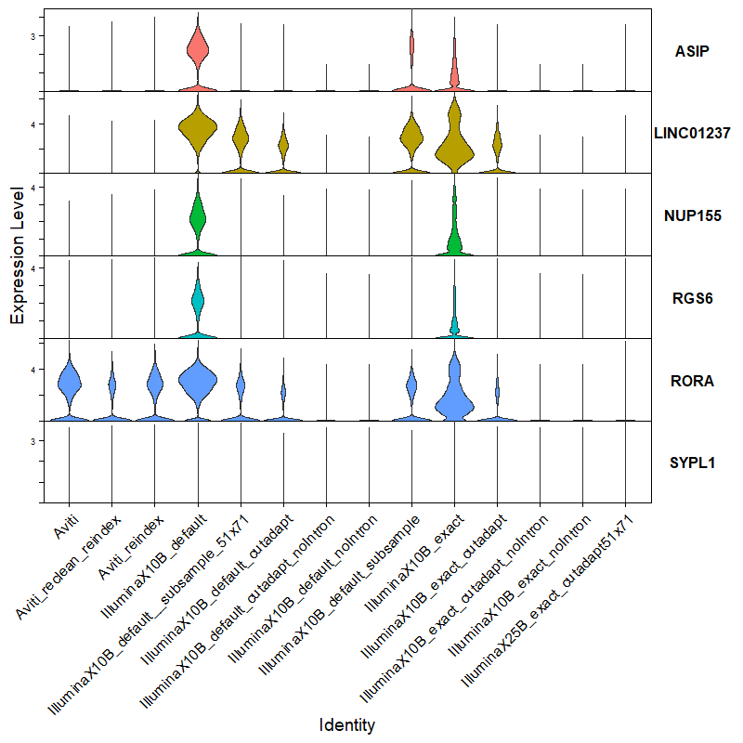
Aviti sequencer: 250M reads (orange)
Novaseq X 10B: 1.5B reads
Default cell calling (blue)
Exact cell calling (green)
Novaseq X 25B: 1.3B reads (purple)
ASIP, LINC01237, and RGS6 no expression at all in any blood cell
NUP155 and SYPL1 minimal expresssion
RORA: only in T cells

